Slide 1
Optimizing bank capital allocation under the Profitability–Liquidity risk trade-off
Master’s study
Field of study Advanced Analytics – Big Data
Written by Ky Anh Le – Student Register No. 140044
Under the supervised of: Mateusz Zawisza, PhD
Institute of Econometrics

Slide 2
Objective
Optimizing bank capital allocation to jointly manage profitability and liquidity risk.
Quantifying the trade-off between banks’ profitability and liquidity risk under uncertainty in interest rates and withdrawal behaviour.
Examining how the risk–return trade-off evolves across different macroeconomic regimes.
Research questions:
“How does bank capital allocation across asset classes shape the trade-off between profitability and liquidity risk under uncertainty in interest rates and withdrawal behaviour, and how does this trade-off evolve across different macroeconomic regimes?”
1

Slide 3
Motivation
Banks face an inherent trade-off between profitability and liquidity resilience because liquid assets are safer but lower-yield, while illiquid assets are more profitable but increase liquidity risk (Freixas & Rochet, 2008).
Liquidity shocks can rapidly threaten otherwise solvent banks, making liquidity management a central issue for both bank stability and systemic risk (Diamond & Dybvig, 1983; Brunnermeier & Oehmke, 2016).
Basel III strengthened this concern by imposing explicit liquidity standards such as the LCR and NSFR (BCBS, 2011; BCBS, 2014)
2

Slide 4
Literature background & Research gap
Prior studies document the relationship between liquidity and profitability, but mostly treat it as an empirical outcome rather than an explicit allocation problem (Bordeleau & Graham, 2010; Berger & Bouwman, 2009).
Basel III–type approaches typically embed liquidity through regulatory ratios and standardized stress assumptions (BCBS, 2011; BCBS, 2013; BCBS, 2014).
Optimization models in banking often remain single-objective, focusing mainly on return maximization under constraints (Markowitz, 1952; Deelstra et al., 2011).
3

Slide 5
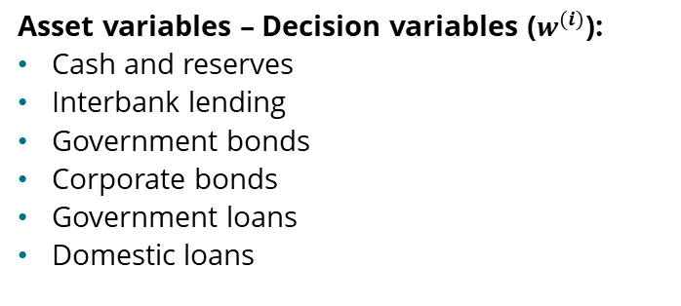
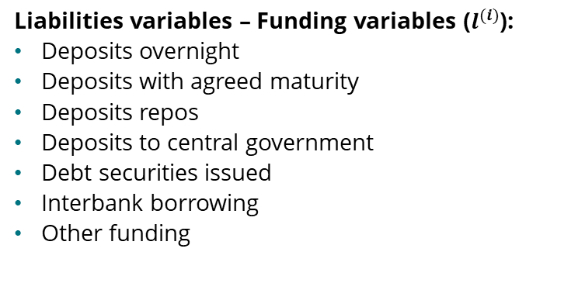
Data
Asset variables – Decision variables ($w^{(i)}$):
Cash and reserves
Interbank lending
Government bonds
Corporate bonds
Government loans
Domestic loans
Liabilities variables – Funding variables ($l^{(i)}$):
Deposits overnight
Deposits with agreed maturity
Deposits repos
Deposits to central government
Debt securities issued
Interbank borrowing
Other funding
Data sources:
Aggregated balance sheet data from Naradowy Bank Polski
Interest rate data from Federal Reserve Economic Data, and Naradowy Bank Polski
Period: January 2005 – December 2025
4

Slide 6
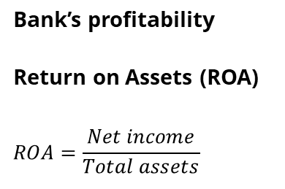
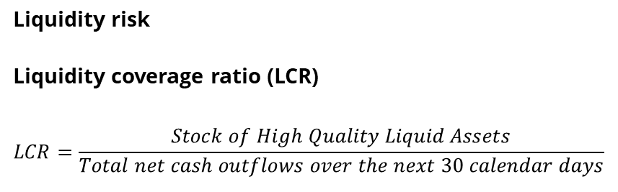
Problem definition
Bank’s profitability
Return on Assets (ROA)
$$ROA=\frac{Net income}{Total assets}$$
Liquidity risk
Liquidity coverage ratio (LCR)
$$LCR=\frac{Stock of High Quality Liquid Assets}{Total net cash outflows over the next 30 calendar days}$$
High liquid assets (cash, reserves, government bonds) strengthen LCR, but usually earn low yields, reducing ROA.
Higher-yield assets (loans, mortgages) support profitability, increasing ROA, but are less liquid, making it harder to meet sudden cash outflows, therefore lower LCR.
5

Slide 7
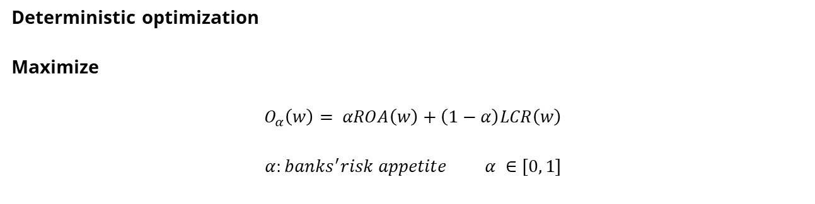
Method
Deterministic optimization
Maximize
$$O_{α}\left(w\right)= αROA\left(w\right)+\left(1−α\right)LCR\left(w\right)$$
$$α:banks^{′}risk appetite α ∈\left[0, 1\right]$$
6

Slide 8
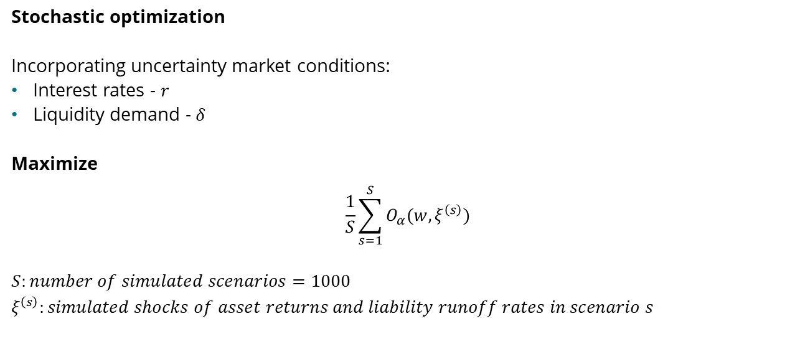
Method
Stochastic optimization
Incorporating uncertainty market conditions:
Interest rates - $r$
Liquidity demand - $δ$
Maximize
$$\frac{1}{S}\sum_{s=1}^{S}{O_{α}(w,ξ^{\left(s\right)})}$$
$$S:number of simulated scenarios=1000$$
$$ξ^{\left(s\right)}:simulated shocks of asset returns and liability runoff rates in scenario s$$
7

Slide 9
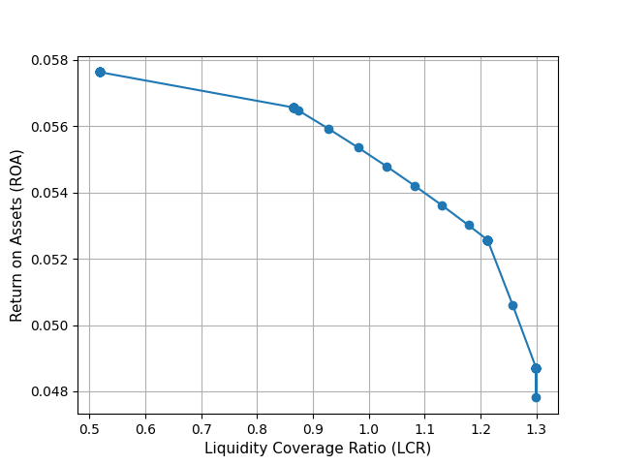
Results
Deterministic: the trade-off is non-linear, the last 0.10 increase in LCR (1.2 – 1.3) costs ~ 0.48 percentage points of ROA, more than the previous 0.33 increase from 0.87 to 1.20 LCR.
5.8
A
Flat at low LCR: ~0.03–0.04 p.p. ROA per +0.1 LCR.
5.6
A
5.4
B
B
Moderate near 1.0–1.2: ~0.12 p.p. ROA per +0.1 LCR.
5.2
5.0
C
C
Very steep beyond 1.2: ~0.48 p.p. ROA per +0.1 LCR.
4.8
8

Slide 10
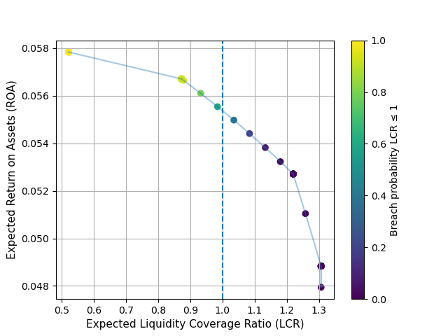
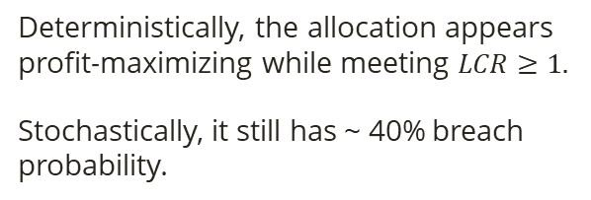
Results
Stochastic: confirms the non-linear trade‑off, stochastic results show that similar allocation portfolio can imply different regulatory safety.
5.8
A
Deterministically, the allocation appears profit-maximizing while meeting $LCR≥1.$
Stochastically, it still has ~ 40% breach probability.
5.6
A
5.4
5.2
5.0
4.8
5

Slide 11
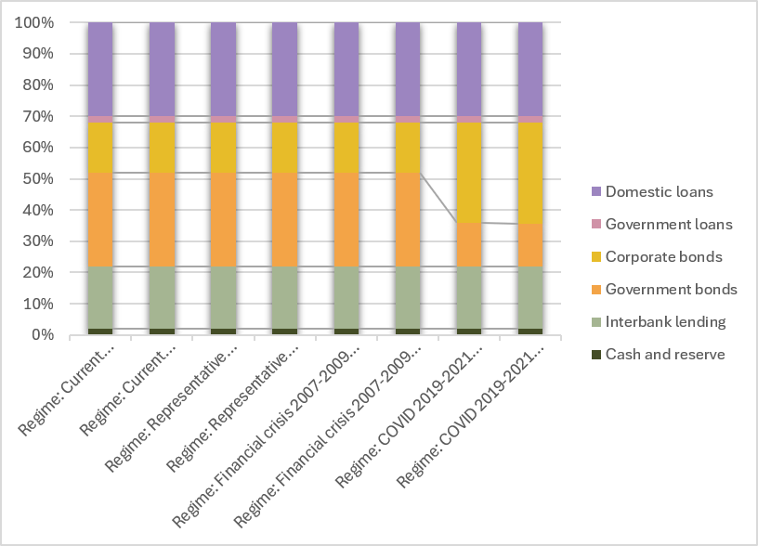
Results
Across regimes, model settings, and under balanced risk appetite, optimal weights remains unchanged except during COVID, when the portfolio rotates from government bonds into corporate bonds.
A
Only the COVID regime triggers reallocation:
government bonds fall from 30% to ~ 14%
corporate bonds rise from 16% to about 32%.
A
7

Slide 12
Conclusion
Profitability – Liquidity trade-off:
The trade-off is non-linear: ROA falls ~ 0.39 percentage points around LCR = 0.87–1.2, but declines ~ 0.5 percentage points once LCR exceeds 1.2.
Impact of stochastic elements:
The stochastic model extends the analysis with the third dimension - LCR breach probability, providing a more decision-relevant measure of liquidity risk.
Optimal assets allocation robustness:
The allocation is identical across all regimes and models, only the COVID regime generates reallocation, mainly a shift from government bonds (~30% to ~14%) to corporate bonds (~16% to ~32%).
This indicates that the balanced optimal portfolio is robust, and changes only under exceptional market conditions.
8

Slide 13
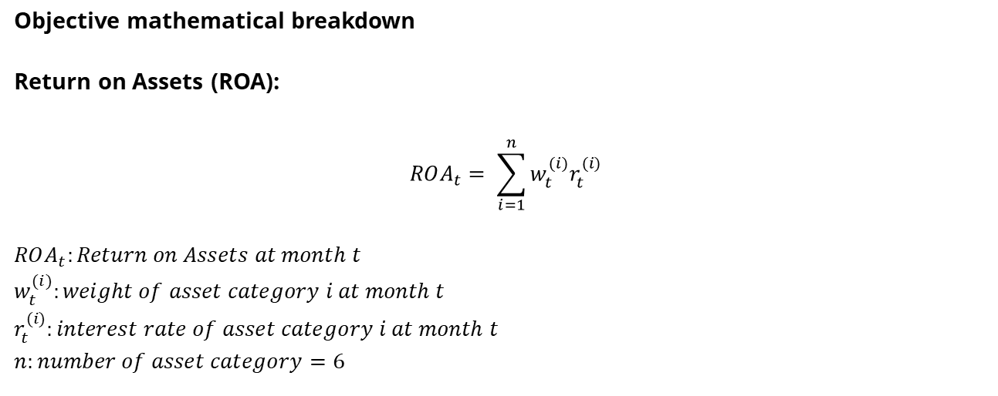
Appendix
Objective mathematical breakdown
Return on Assets (ROA):
$$ROA_{t}= \sum_{i=1}^{n}{w_{t}^{(i)}r_{t}^{(i)}}$$
$$ROA_{t}:Return on Assets at month t$$
$$w_{t}^{(i)}:weight of asset category i at month t$$
$$r_{t}^{(i)}:interest rate of asset category i at month t$$
$$n:number of asset category=6$$

Slide 14
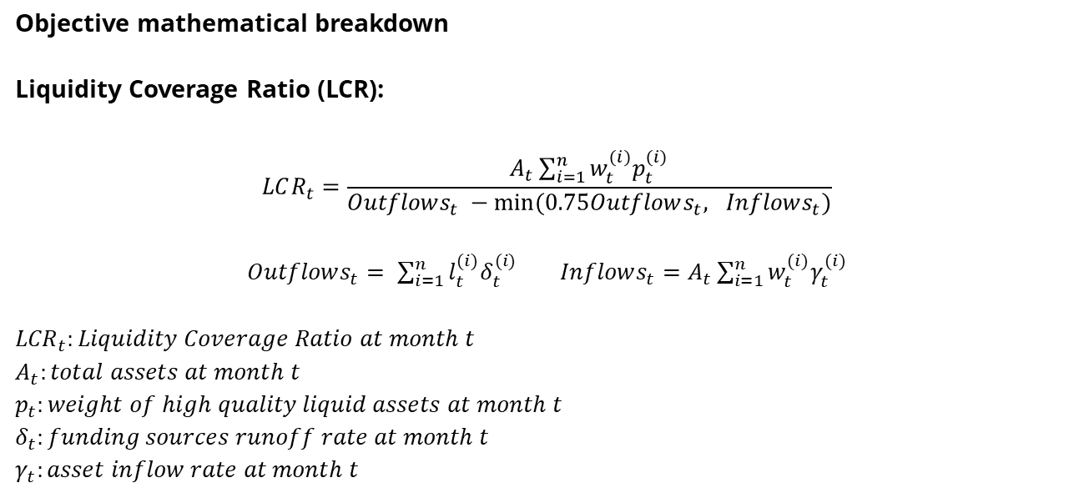
Appendix
Objective mathematical breakdown
Liquidity Coverage Ratio (LCR):
$$LCR_{t}=\frac{A_{t}\sum_{i=1}^{n}{{w_{t}^{(i)}p}_{t}^{(i)}}}{Outflows_{t} −min⁡(0.75Outflows_{t}, Inflows_{t})}$$
$Outflows_{t}= \sum_{i=1}^{n}{l_{t}^{(i)}δ_{t}^{(i)}}$ $Inflows_{t}=A_{t}\sum_{i=1}^{n}{w_{t}^{(i)}γ_{t}^{(i)}}$
$${LCR}_{t}:Liquidity Coverage Ratio at month t$$
$$A_{t}:total assets at month t$$
$$p_{t}:weight of high quality liquid assets at month t$$
$$δ_{t}:funding sources runoff rate at month t$$
$$γ_{t}:asset inflow rate at month t$$

Slide 15
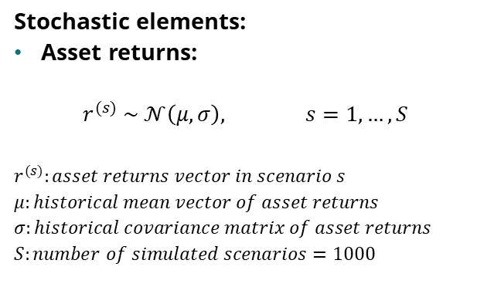
Appendix
Stochastic elements:
Asset returns:
$$r^{(s)} \sim 𝒩\left(μ, σ\right), s=1,…, S$$
$$r^{(s)}:asset returns vector in scenario s$$
$$μ:historical mean vector of asset returns$$
$$σ:historical covariance matrix of asset returns$$
$$S:number of simulated scenarios=1000$$
Asset-return uncertainty is modeled by drawing scenario returns from a multivariate normal distribution calibrated to historical means and covariances.
This captures both the average profitability of each asset class and their co-movements over time.

Slide 16
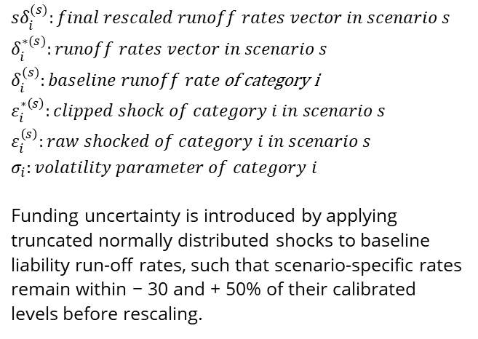
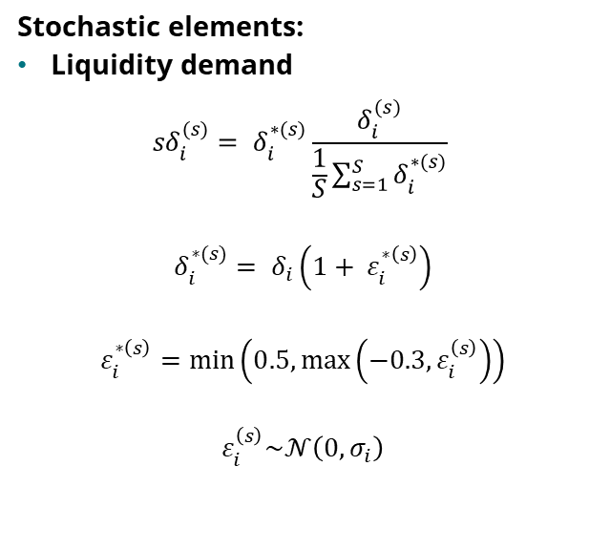
Appendix
Stochastic elements:
Liquidity demand
$${sδ}_{i}^{(s)}= δ_{i}^{∗(s)}\frac{δ_{i}^{(s)}}{\frac{1}{S}\sum_{s=1}^{S}{δ_{i}^{∗(s)}}}$$
$$δ_{i}^{∗(s)}= δ_{i}\left(1+ ε_{i}^{∗\left(s\right)}\right)$$
$$ε_{i}^{∗\left(s\right)}=\min\left(0.5,\max\left(−0.3, ε_{i}^{\left(s\right)}\right)\right)$$
$$ε_{i}^{\left(s\right)}\sim 𝒩\left(0, σ_{i}\right)$$
$${sδ}_{i}^{(s)}:final rescaled runoff rates vector in scenario s$$
$$δ_{i}^{∗(s)}:runoff rates vector in scenario s$$
$δ_{i}^{(s)}:baseline runoff rate$ of category i
$$ε_{i}^{∗\left(s\right)}:clipped shock of category i in scenario s$$
$$ε_{i}^{\left(s\right)}:raw shocked of category i in scenario s$$
$$σ_{i}:volatility parameter of category i$$
Funding uncertainty is introduced by applying truncated normally distributed shocks to baseline liability run-off rates, such that scenario-specific rates remain within − 30 and + 50% of their calibrated levels before rescaling.

Slide 17
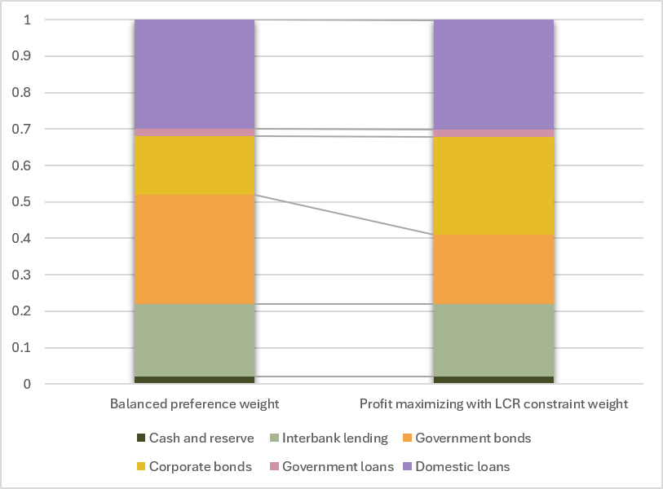

Appendix
Deterministic case, current market: Profit maximization under LCR ≥1 is achieved through reallocation from government bonds to corporate bonds.
A
The key shift is from:
government bonds: 30.0% $→$ 18.93%
corporate bonds: 16.0% $→$ 27.0%
A
7

Slide 18
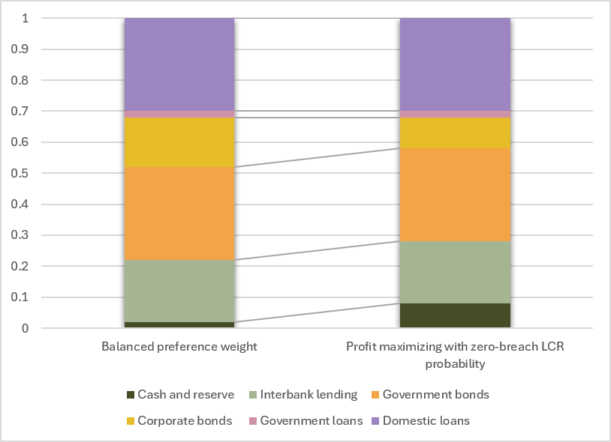
Appendix
Stochastic, current market: under zero LCR breach probability constraint, the stochastic optimum becomes far more conservative than the deterministic optimum.
A
The portfolio shifts toward more liquid assets:
cash and reserves: 2% → 8%
corporate bonds: 16% → 10%
to achieve the zero-breach probability.
A
7

Slide 19
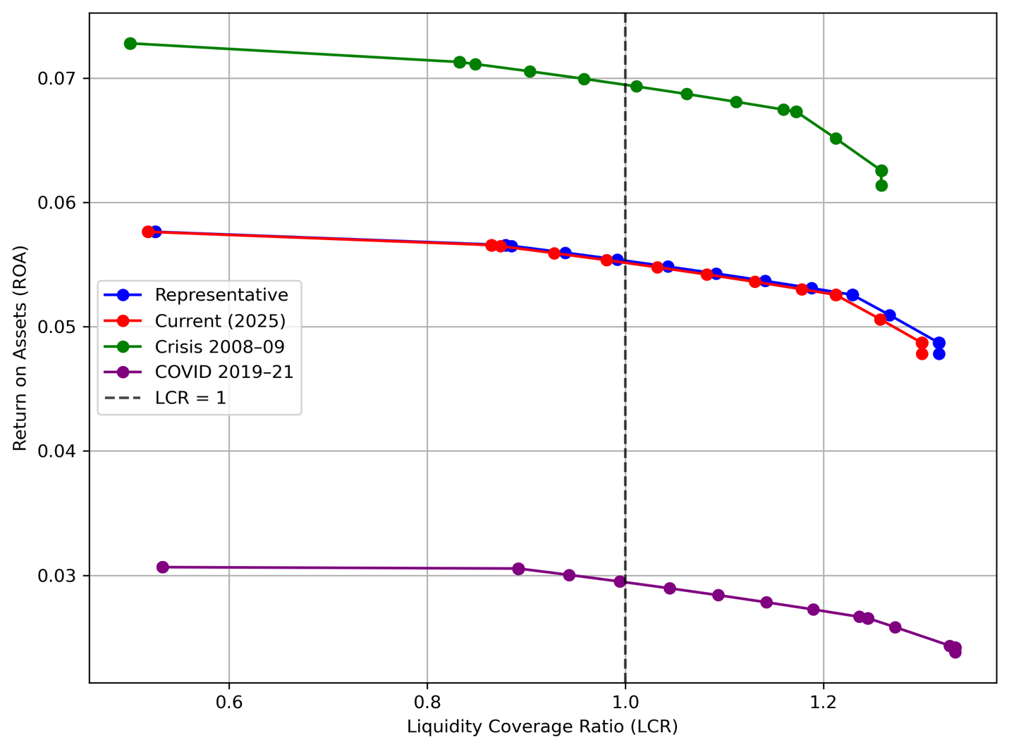
Appendix
Deterministic case: The profitability–liquidity trade-off is consistent across regimes, with COVID showing the lowest ROA.
7.0
6.0
5.0
Return on Assets (ROA)
4.0
3.0
Liquidity coverage ratio (LCR)

Slide 20
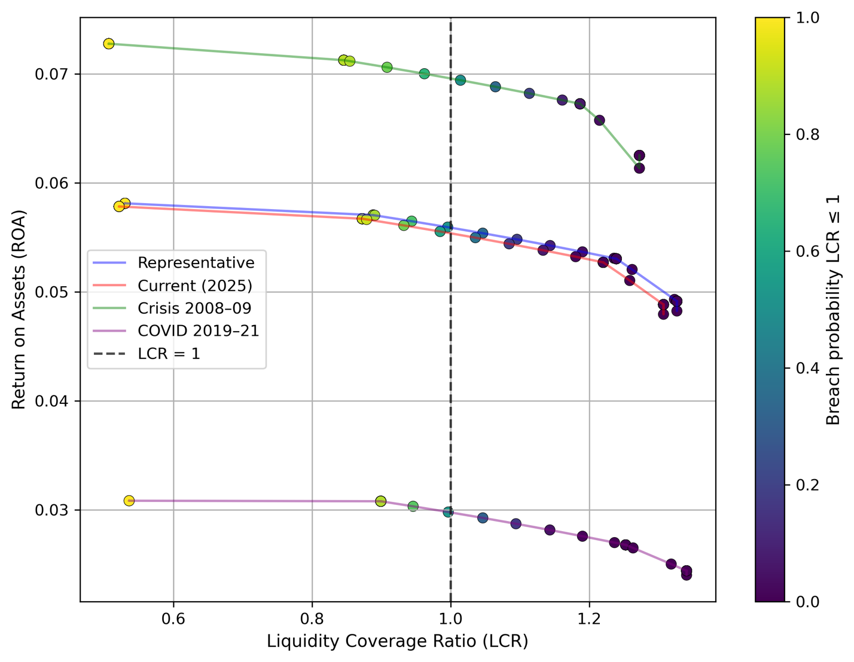
Appendix
Stochastic case: in line with deterministic case, extends the analysis with the breach probability measurement.
7.0
6.0
5.0
Return on Assets (ROA)
4.0
3.0
Liquidity coverage ratio (LCR)

Slide 21
Appendix
Limitations:
The model is based on a stylized balance sheet representation with asset-class weights as decision variables, so it abstracts from many institution-specific features such as funding structure, customer behaviour, etc.
Results depend on the assumed stochastic stress structure.
It focuses mainly on LCR-based short-term liquidity risk, but the long-term metrics.
Future research
Extend the model to bank-level data.
Include long-term liquidity measurement - Net Stable Funding Ratio (NSFR) and other regulatory constraints.
Test robustness under broader systemic stress scenarios.
8

Slide 22
Appendix
Basel Committee on Banking Supervision (2011), Basel III: A global regulatory framework for more resilient banks and banking systems, BIS
Basel Committee on Banking Supervision (2013), Basel III: The Liquidity Coverage Ratio and liquidity risk monitoring tools, BIS
Berger, A.N., & Bouwman, C.H.S. (2009), Bank liquidity creation, Review of Financial Studies
Bordeleau, É., & Graham, C. (2010), The impact of liquidity on bank profitability, Bank of Canada Working Paper
Diamond, D.W., & Dybvig, P.H. (1983), Bank runs, deposit insurance, and liquidity, Journal of Political Economy
Brunnermeier, M.K., & Oehmke, M. (2013), The maturity rat race, Journal of Finance
Deb, K. (2001), Multi‑objective Optimization using Evolutionary Algorithms, Wiley
Miettinen, K. (1999), Nonlinear Multiobjective Optimization, Kluwer Academic Publishers
Kall, P., & Wallace, S.W. (1994), Stochastic Programming, Wiley
Freixas, X., & Rochet, J.‑C. (2008), Microeconomics of Banking, MIT Press
9

